Slide 1


TestifAI: A Comprehensive Testing Framework for Safe AI Arooj Arif ¹, Alexandros Koliousis¹, Elena Botoeva² ¹Northeastern University, ²Kent University
London Hopper Colloquium 2024
Research Spotlight Competition
Notes:
1

Slide 2
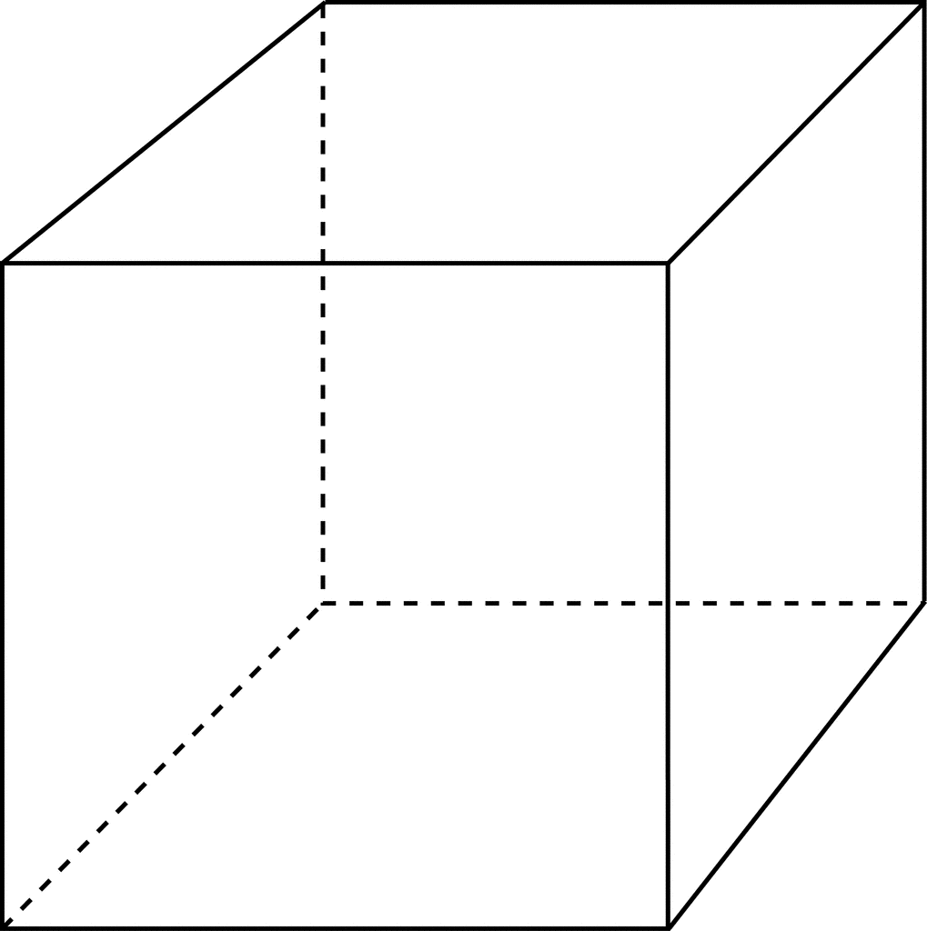
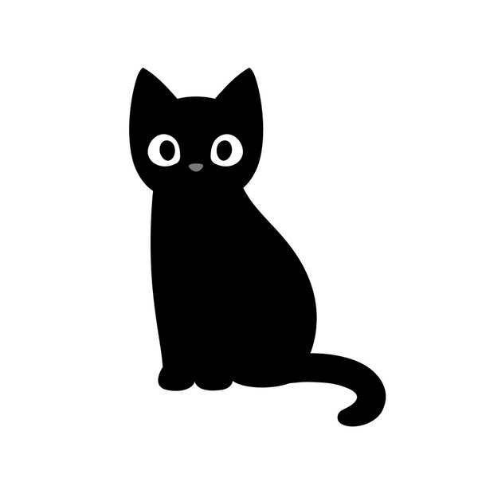

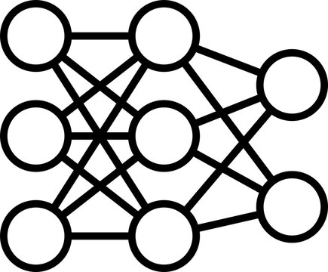


Enhancing Safety in AI: The Urgency of Thorough Testing
AI is used in safety critical systems (healthcare, automotive, avionics).
Neural Networks are sensitive to perturbations.
Perturbed Value
$$ε$$
DOG
Original Pixel
CAT
NN
NNs, just like standard programs, need to be tested for correctness.
Core Challenge: How to test an AI System thoroughly?
London Hopper Colloquium 2024
Research Spotlight Competition
Notes:
so over the past decade we've seen some tremendous growth in artificial intelligence across safety critical domains .
in the field of autonomy and Robotics we now have models that can make critical decisions about things like self-driving at a second's notice and these are Paving the way for fully autonomous vehicles and robots and that's not where this stops in the field of medicine and Healthcare robots are now equipped to conduct life-saving surgery we have algorithms that generate predictions for critical drugs that may cure diseases that we previously thought were incurable and we have models that can automatically diagnose diseases without intervention from any Health Care Professionals at all these advances are revolutionary and they have the potential to change Life as we know it today but there's another question that weneed to ask which is where are these models in real life a lot of these Technologies were innovated five ten
years ago but you and I don't see them in our daily lives so what is what's the Gap here between Innovation and deployment the reason why you and I can't go buy self-driving cars or robots don’t typically assist in operating rooms is this these are some headlines about the failures of AI from the last few years alone in addition to these incredible Advantage advances we've also seen catastrophic failures and every single one of the safety critical domains I just mentioned
these problems range from crashing autonomous vehicles to healthcare algorithms that don't actually work for everyone even though they're deployed
out in the real world so everyone can use them now at a first glance this seems really demoralizing if these are all of the
things wrong with artificial
intelligence how are we ever going to
achieve that vision of having our AI
integrated into the fabric of our daily
lives in terms of safety critical
deployment
but at them is this is exactly the type
of problem that we solve we want to
bring these advances to the real world
and the way we do this is by innovating
in the Spheres of safe and trustworthy
artificial intelligence in order to
bring the things that were developed in
research labs around the world to
customers like you and me
and we do this by our core ideology is
that we believe that all of the problems
on this slide are underlaid by two key
Notions the first is bias
bias is what happens when machine
learning models do better on some
demographics than others this results

Slide 3
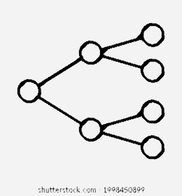

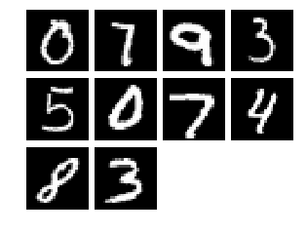
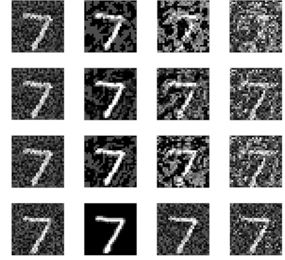

A Comprehensive Testing Framework for AI Systems
A conceptual framework that includes:
An end-to-end pipeline
An error summarization approach for model refinement
Local and global correctness
Specifications
Sampling
Testcase Generation
Testing
Error Summarization
clearly define all necessary properties of the system
gather all relevant samples necessary for thorough model testing
generate different testcases according to the specified properties
assessing local and global correctness
graphical error reports and recommendations for model refinement.
Rotation
Noise
….
Brightness
London Hopper Colloquium 2024
Research Spotlight Competition
3

Slide 4



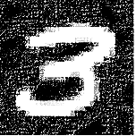
AI System: The Sum of two Digits using an MNIST Classifier
Maximum probability of correct answer for this pair
MAX(GL_{n}, GL_{r}) = 0.43
+
= 12
Minimum probability
MIN(GL_{n}, GL_{r}) = 0.23
Optimistic view
Pessimistic view
+
= 12
+
= 12
GL_{n} = LO_{n}(9) * Lo_{n}(3) = 0.43
GL_{r} = LO_{r}(9) * Lo_{r}(3) = 0.23
Global Correctness
9 |
3 |
9 |
3 |
…
…
…
…
LO_{n}(9) = 0.66
LO_{n}(3) = 0.65
LO_{r}(9) = 0.46
LO_{r}(3) = 0.50
Local Correctness
…
…
…
…
Noise property
Rotation property

Slide 5
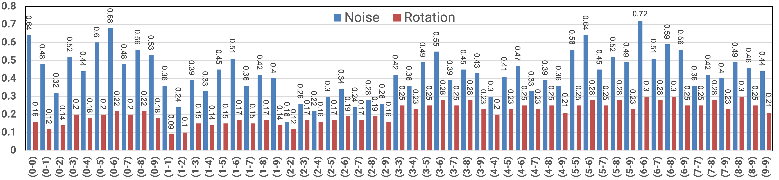
Evaluation for the Sum of two Digits on 1000 samples
We tested 55 unique pairs {d₁, d₂} for 0 ≤ d₁, d₂ ≤ 9
For each pair {d₁, d₂}, the digits were sampled randomly from the corresponding class
We computed the minimum probabilities for each pair (L₁, U₁), …, (L₅₅, U₅₅)
The global pessimistic correctness is 9%
The global optimistic correctness is 72%
London Hopper Colloquium 2024
Research Spotlight Competition
5
Notes:
Experimental Setup
Model Architecture
CNN, ResNet architecture
Dataset
MNIST Dataset
Sampling
Random Sampling
100 samples from each class (0-9)
5

